Slide 1


Flight Delay Analytics

Slide 2
Introduction
Flights Data Summary
Scope: US domestic flights
Time Period November2021 - December 2021
Key Features
Flight date, reporting airline, flight number
Tail number, origin, and destination airports
Departure and arrival times
Delays, cancellations, and diversions
Distance, airtime, and elapsed time
Focus of Analysis
Analysis Focus: Understanding and Predicting Flight Delays
Objective: Gain insights into factors influencing flight delays and develop a machine learning model to predict delay times.
Key Areas of Focus
Identifying patterns and trends in historical delay data.
Analysing the impact of various features (airlines, airports, time) on delays.
Utilizing machine learning to predict and quantify arrival delay times.
Importance
Enhancing operational efficiency for airlines.
Providing travellers with more accurate arrival time estimates.
Informing airport and airline strategies for minimizing delays.

Slide 3
Agenda
What we will go through
Our analysis will be focus on the following:
Flight Delays
Overview
By Airline Analytics
By Time Analytics
By Location Analytics
Causes of Delay
Recommendation: A Machine Learning Solution
Overall Insights and Recommendations
Thank you!
Q&A

Slide 4
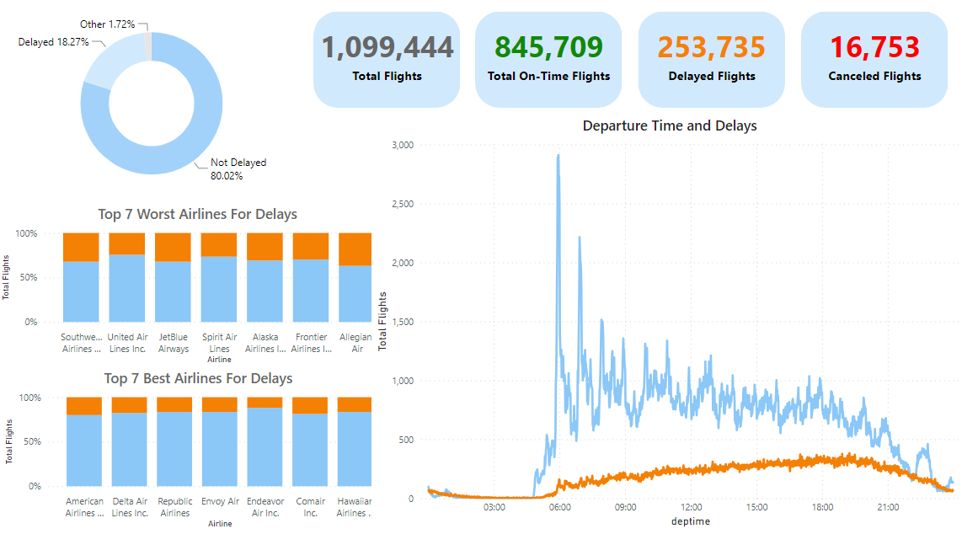
Overview
Flight Delays Analytics
Understanding the data
We have about 1.1m flights and flight data, 850k are on time flights, 250 are delayed and 16k cancelled.
Here we can see a summary of the key elements we will touch on such as:
How airline choice impacts delays?
How timing, be that days, weeks, months or time of day can impact the delay risk?
How delays differ between locations and airports in the states?
For context a delayed flight is defined as being delayed either at Arrival or at Departure.

Slide 5
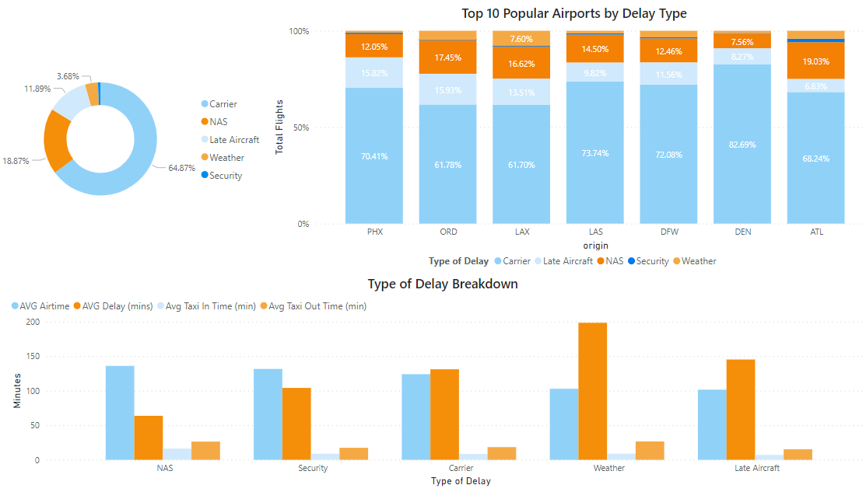
General Causes of Delays
Flight Delays Analytics
Key Insights
The types of delay within the data are carrier, National Aviation System (NAS), Late Aircraft, Weather and Security.
The main cause of delays 65% is carrier delays, due to the work done between aircrafts landing and being ready for a flight
The other key causes are NAS (19%) and Late Aircraft (12%).
When broken down by the 10 most popular airports we see this distribution is consistent but in PHX and DEN.
We see that average delay for weather (200mins) leads to massive delays even though the delay is less common.
Now we will explore these delays in more details.

Slide 6
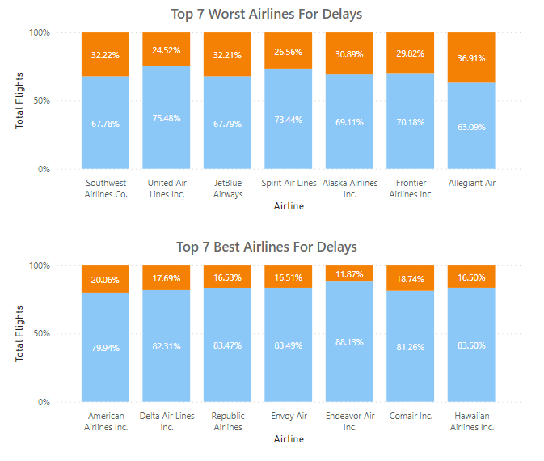
Delays by Airline
Flight Delays Analytics
Key Insights
The Worst flights for risk of delays is Allegiant Air (~37%) and Southwest Airlines (~32%).
Allegiant is an ultra-low-cost U.S. carrier that operates scheduled and charter flights.
Southwest Airlines is the largest low-cost carrier in the USA.
The best flights to avoid delays are Endeavor Air (~12%) and Hawaiian Airlines (~17%).
Endeavour’s focus is to provide a high-quality, cost-competitive, customer focused flights.
Hawaiian airline a higher end carrier with a greater focus on customer satisfaction with it being a famous tourist attraction.
For a reference point the average delayed flights sat at 23% thus these airlines are significantly away from this.

Slide 7
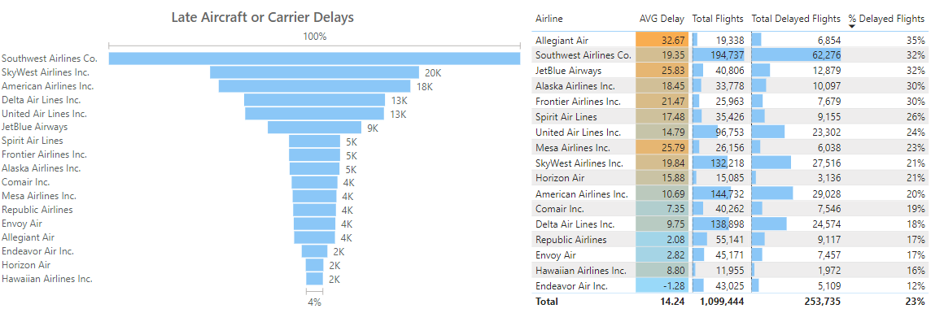
Delays by Airline (cont)
Flight Delays Analytics
Key Insights
Going into further detail we can see a waterfall chart showing the Late Aircraft or Carrier Delays these would be delays that the airlines can fix.
Here the worst performers are Southwest at 40k and SkyWest at 20k.
We note Allegiant Airline Seems to be much lower down the list – however on further inspection it simply has a lower number of flights however 4k of its 6.8k delays flights are due to the airline 58% showing there are significant improvements to be had.

Slide 8
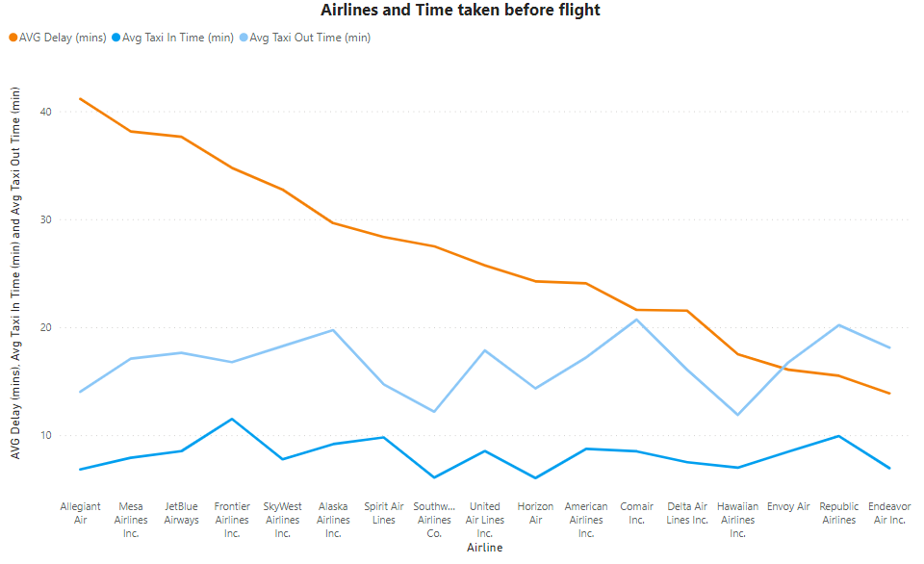
Delays by Airline (time)
Flight Delays Analytics
Key Insights
While Southwest is quite bad for risk of delays, the amount of time delayed is not so bad at 27 mins.
Southwest also has strong values for the other metrics, performing above average.
The worst is once again Allegiant Air with an average delay time of 40 mins.
The best performers here are the bottom 4 with under 18 mins delays for these with the average delay being 25 mins.
Comer and Republican Airlines have the worst Taxi out time over 20 mins, showing inefficiency between gate and take off.
Taxi In time there is not a major difference between airlines, the best at 6 mins the worst at 11 mins.

Slide 9
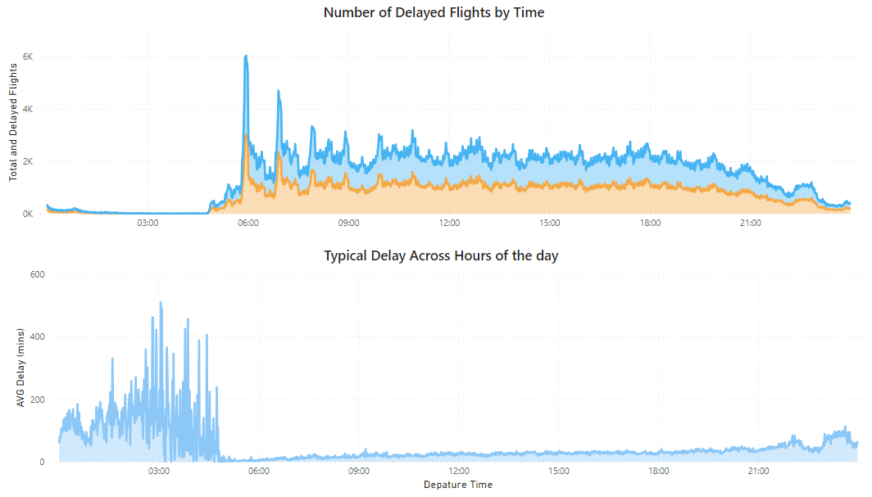
How Time of day impacts delays?
Flight Delays Analytics
Key Insights
Early flights from midnight to the early morning tend to be less likely to be delayed.
Likely due to much there being much less flights in the mornings making them less busy compared to the rest of the day.
On the contrary to avoid massive time delays the late night to morning period is the worst demonstrating the trade-off between these.

Slide 10
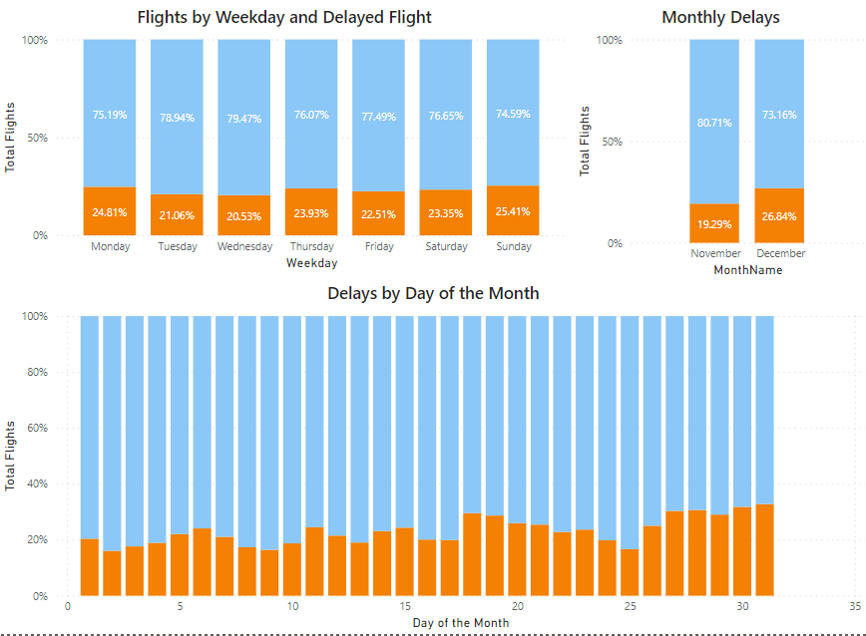
How days impact delays?
Flight Delays Analytics
Key Insights
The worst days of the week for travel are Sunday and Monday with the highest risks of delays at ~25%.
The best is mid-week flights with Tuesday and Wednesday sitting around ~21%.
For the 2 months in the year December (~27%) is significantly worse for delays – given the holiday season this is expected.
For days months the ends of the month see a peak in delays, around 30% of flights being delays.
There is also a peak around 18th however, this is influenced by December flights & delays – as flights just before Christmas increased.

Slide 11
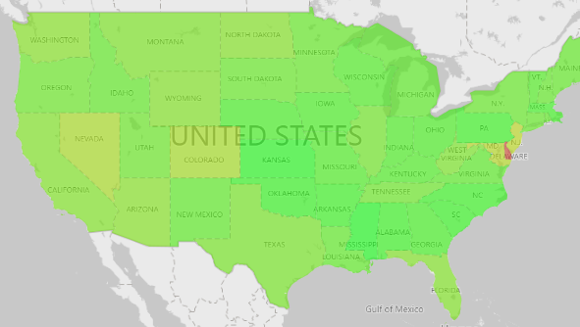
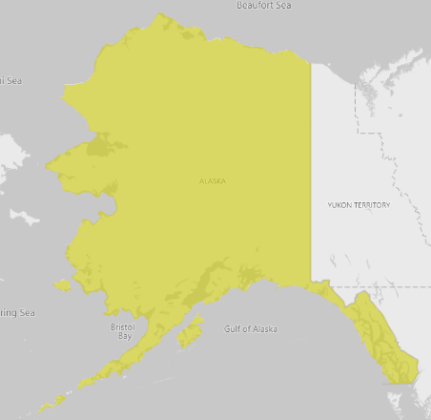
How Location impacts delays?
Flight Delays Analytics
Key Insights
The worst states for delays were Delaware Alaska, New Jersey and Maryland all with >30% delayed flights.
The best states we Mississippi, Kanas, South Carolina and Oklahoma sitting at <17% delays.
A lot of the states were quite evenly distributed with % of Flight delays sitting between 19% – 26% for most states.
We will delve into the best and worst performing states.

Slide 12
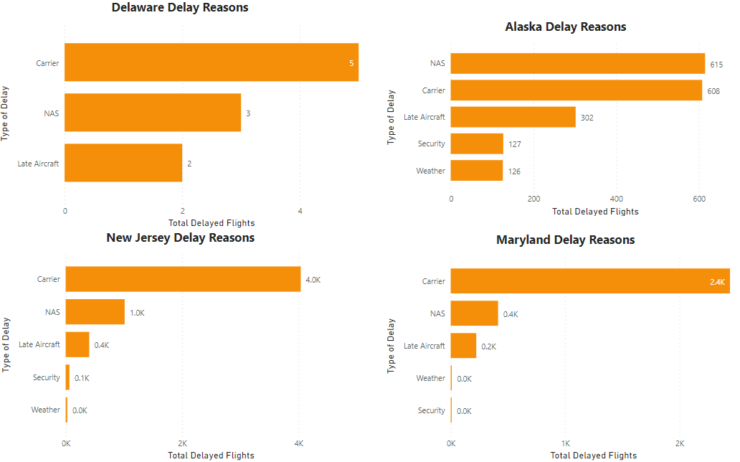
The Worst States for Delays
Flight Delays Analytics
Key Insights
Delaware: had a 65% delayed flights rate however, in this data set there were only 17 flights from here this is the key driver for it being so much higher than others.
Alaska: delays were mainly driven by National Airspace System (NAS) and Carrier Delays.
New Jersey: we see significant delays due to carriers 4k, showing this is an airline issue
The airline that takes over 50% of NJ flights is United Airlines which is in the Top 7 worst airlines.
Maryland: we see significant delays due to carriers 2.4k, showing this is also an airline issue
United Airlines and JetBlue make up over 45% of Maryland's delays and these were in the Top 7 worst airlines for delays.

Slide 13
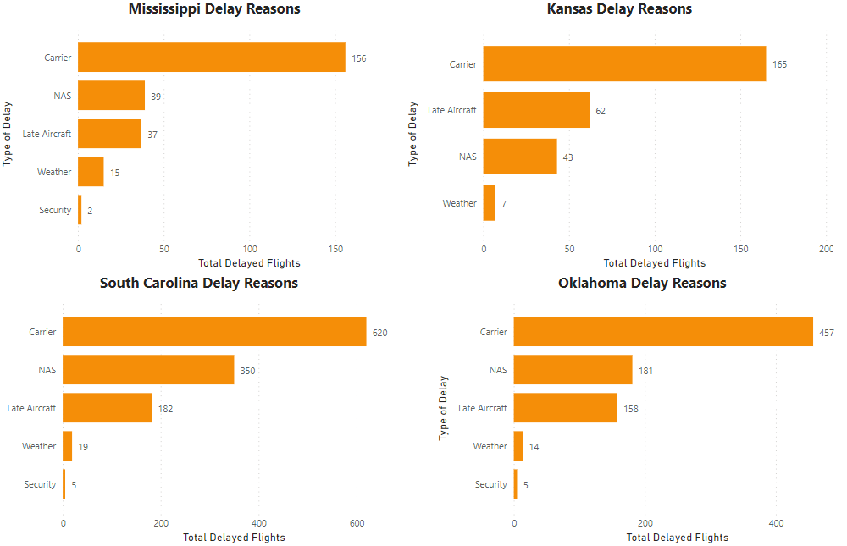
The Best States for Delays
Flight Delays Analytics
Key Insights
Mississippi & South Carolina had a 14% and 16% delayed flights rate respectively, most of which relate to carrier delays.
They both had a wide variety of Airlines, with Comar Inc being its main one, Comar has a delay rate of 17% reflecting the better performance of this state.
Kansas: delays were mainly driven by Late Aircraft and Carrier Delays. Sky West Airline was the main one used in Kansas this had below average delays.
Oklahoma: we see delays are mostly carrier delays.

Slide 14
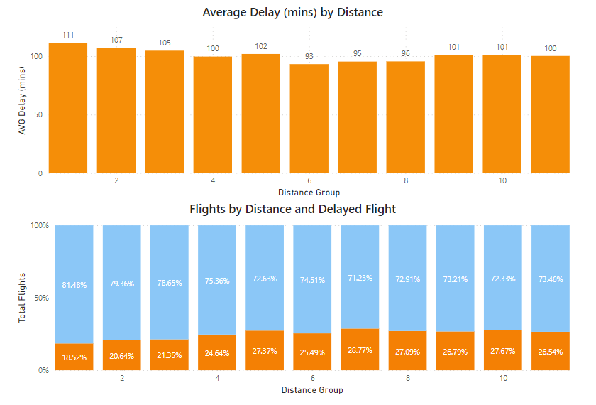
How distance impacts delays?
Flight Delays Analytics
Key Insights
Each of these distance groups is 250 miles.
The general trend is that further flights tend to be more delayed, those above group 7 (1750 miles) tend to have delay rates of 27%.
Short flights especially those in group 1 (<250miles) have delay rates much lower at 19%.
Time of delay is actually pretty evenly distributed across distance with the range being 18 mins.
This is likely driven by other features we have discussed such as states, timing and airlines.

Slide 15
Recommendation: A Machine learning Solution
The Chosen Problem: How long will a particular flight be delayed?
Problem
Can we create a solution to predict the minutes on arrival that a particular flight will be delayed?
Can we do this ideally with information that would be available before a flight is delayed?
Approach
The approach involves leveraging machine learning techniques to build a predictive model.
The primary goal is to develop a model that can forecast the arrival delay minutes for flights based on various features and historical data.
Features include factors such as departure time, origin and destination airports, airline information, and more.
Solution
The final solution employs the XGBoost algorithm (summary to follow), machine learning technique known for its accuracy and versatility.
XGBoost, through its ensemble of decision trees, excels at learning complex patterns and relationships within the data. It iteratively refines its predictions, considering the mistakes of previous iterations.

Slide 16
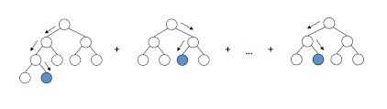
Recommendation: A Machine learning Solution
eXtreme Gradient Boosting XGBboost Background
Algorithm Overview (an insightful Analogy)
You're faced with the challenge of predicting flight arrival minutes accurately. Enter XGBoost, your team of experts, each specializing in understanding and forecasting specific nuances of the arrival delay.
Team of Experts (Decision Trees)
XGBoost assembles a team of decision-makers – think of them as experts in aviation. Each decision tree focuses on certain conditions like departure time, historical data, and airline patterns to make individual predictions.
Learning from Mistakes (Gradient Boosting)
XGBoost excels in learning from past mistakes. It starts with a basic understanding of arrival patterns and builds subsequent models that specifically target areas where earlier predictions fell short. This iterative process continues until the model fine-tunes its accuracy.
Handling Complexity (Regularization)
To prevent the team from getting too specialized and making predictions that are too tailored to past data (overfitting), XGBoost uses a technique called regularization. It introduces rules to ensure the team's predictions remain balanced and adaptable to new scenarios.
Smart Training (Gradient Descent)
XGBoost trains its team of aviation experts intelligently. Instead of bombarding them with all the data at once, it takes gradual steps, adjusting predictions iteratively to improve accuracy over time. It's like providing ongoing training sessions to enhance their forecasting skills.
Flexibility and Power (Ensemble Method)
By combining the predictions of multiple decision trees – your team of aviation experts – XGBoost becomes a flexible and powerful model. It can analyse diverse factors like airport conditions, flight history, and seasonal variations to provide a comprehensive and accurate prediction of arrival minutes.

Slide 17
The Chosen Model
Flight Delays Analytics
Model Summary: Predicting Flight Delays
Model : XGBoost Regressor
Features Selected
Time-related Features: Year, quarter, month, day of month, day of week, flight date.
Airline and Flight Identification: Reporting airline, DOT ID reporting airline, IATA code reporting airline, tail number, flight number reporting airline.
Origin and Destination Details: Origin and destination airport ID, airport sequence ID, city market ID, city name, state, state FIPS code, state name, WAC (World Area Code).
Timing Information: CRS (Computerized Reservation System) departure time, departure time, CRS arrival time, arrival time.
Duration and Distance: CRS elapsed time, actual elapsed time, airtime, distance, distance group.
Other Parameters: Number of flights, arrival delay minutes.
Model Parameters
Default parameters for XGBoost Regressor used initially.
Parameters include learning rate, maximum depth of trees, number of trees, and more.
Training and Testing
Data split into training and testing sets (80/20 ratio).
Model trained on historical data and evaluated on a separate test set.
Model Performance
Mean Squared Error (MSE) | Root Mean Squared Error (RMSE) | R – Squared (R2) Score
279.37 | 16.71 | 87%

Slide 18
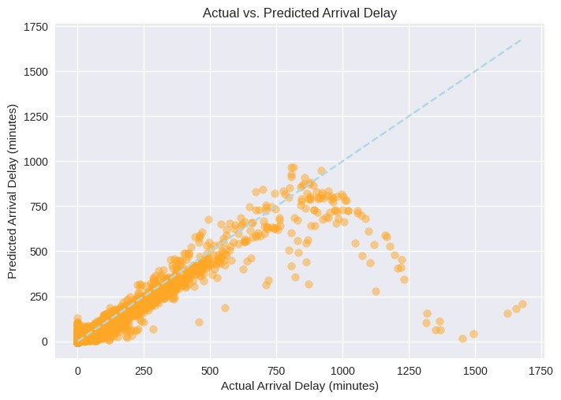
Delays by Airline
Flight Delays Analytics
Key Insights
Here we see the model can predict the time of delay very well.
The ideal case shown by the blue line is where we want most points to be
We note the current model finds difficulty predicting longer delays especially those around 1500 mins.
Able to predict average delay within ~12 mins this can be very beneficial for multiple stakeholders.
Model Improvements
Adding more data
Focusing on predicting longer delays more accurately.
Data is only for 2 months of 2021

Slide 19
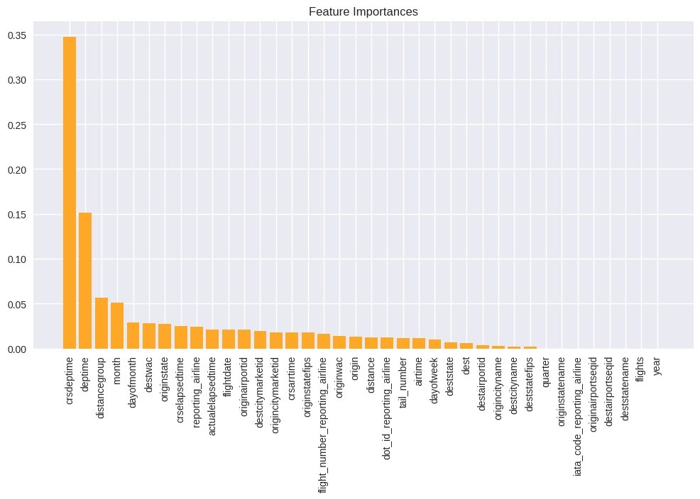
Important Features for Predicting Delays
Flight Delays Analytics
Key Insights
Feature importance in machine learning refers to the measure of the contribution of each individual feature in a predictive model towards making accurate predictions.
The scheduled timing of Departures and Arrival is a key contributor to the model predictions. Alongside the departure time.
Deptime also has significant predictive power at 12%.
Distance also has an impact at just over 5% feature importance.
The state and airline do have some influence on the predictive power of this model sitting at about 2% – 3%.
Features such as year and quarter have no predictive power as the data is localised to one period.

Slide 20
Summary: Recommendations and Insights
Recommendations
Enhance Carrier Performance
Establish collaborative initiatives with high-risk carriers to analyse and rectify operational inefficiencies.
Implement regular performance monitoring systems to track improvements and identify persistent challenges.
2. Improve Airport Efficiency
Implement strategies to reduce taxi-out times, especially for airlines with delays caused by inefficiencies.
Streamline the process between gate and take-off to enhance overall airport efficiency and minimize delays.
3. Strategic Scheduling
Consider adjusting flight schedules to avoid peak delay periods, particularly during late-night to morning hours.
Advise customers to avoid flights at the ends of the month or prior to Christmas, as these periods experience higher delays.
4. State-Specific Strategies
Implement targeted strategies in states with high delay rates (e.g., Delaware, Alaska, New Jersey, Maryland) to address specific issues.
Facilitate knowledge-sharing among states with lower delay rates (e.g., Mississippi, Kansas, South Carolina, Oklahoma) to promote best practices.
5. Airline Performance Management
Directly intervene with airlines identified as bad performers, providing tailored support to improve their operational efficiency.
Increase customer awareness regarding airlines with historically poor performance, allowing informed decision-making during flight bookings.

Slide 21

Thanks for Listening Any Questions?

